Slide 1
CS5412:
DIVING IN: INSIDE THE DATA CENTER
CS5412 Spring 2014 (Cloud Computing: Birman)
Lecture V
Ken Birman

Slide 2
Data centers
Once traffic reaches a data center it tunnels in
  First passes through a filter that blocks attacks
  Next, a router that directs it to a “tier one” computer (one of many) hosting the proper services
  Each hosted company has its own “domain” but also runs inside a kind of virtual enterprise: looks like a private network, with its own IP addresses etc.
  These can make use of shared services provided by the cloud provider, like file system services
CS5412 Spring 2014 (Cloud Computing: Birman)

Slide 3
Tier two and Inner Tiers
If tier one faces the user and constructs responses, what lives in tier two?
  Caching services are very common (many flavors)
  Other kinds of rapidly responsive lightweight services that are massively scaled
  Inner tier services might still have “online” roles, but tend to live on smaller numbers of nodes: maybe tens rather than hundreds or thousands
CS5412 Spring 2014 (Cloud Computing: Birman)

Slide 4
Tier two and Inner Tiers
Tiers one and two soak up the load
  This reduces load on the inner tiers, and in fact there may be further layers of caching to soak up load outside the data center (Akamai, Facebook edge, etc.)
Many services use asynchronous streams of updates
  Send updates “down” towards inner services
  but don’t wait and don’t hold locks!
  Notifications percolate up, often showing up
  much later. Meanwhile, tier one runs with
  potentially out-of-data cached data.
Tier 1 Service
Tier 1 Service
Tier 1 Service
Tier 1 Service
Tier 1 Service
Backend DB
CS5412 Spring 2014 (Cloud Computing: Birman)

Slide 5
Contrast with “Back office”
A term often used for services and systems that don’t play online roles
  In some sense the whole cloud has an outward facing side, handling users in real-time, and an inward side, doing “offline” tasks
  Still can have immense numbers of nodes involved but the programming model has more of a batch feel to it
For example, MapReduce (Hadoop)
CS5412 Spring 2014 (Cloud Computing: Birman)

Slide 6
Some interesting services we’ll consider
Memcached: In-memory caching subsystem
Dynamo: Amazon’s shopping cart
BigTable: A “sparse table” for structured data
GFS: Google File System
Chubby: Google’s locking service
Zookeeper: File system with locking, strong semantics
Sinfonia: A flexible append-only logging service
MapReduce: “Functional” computing for big datasets
CS5412 Spring 2014 (Cloud Computing: Birman)

Slide 7
Connection to DHT concept
Last time we focused on a P2P style of DHT
These services are mostly built as layers over a data center DHT deployment
  Same idea and similar low-level functionality
  But inside the data center we can avoid costly indirect routing. We’ll discuss that next time.
CS5412 Spring 2014 (Cloud Computing: Birman)

Slide 8
Memcached
Very simple concept:
  High performance distributed in-memory caching service that manages “objects”
  Key-value API has become an accepted standard
  Many implementations
Simplest versions: just a library that manages a list or a dictionary
Fanciest versions: distributed services implemented using a cluster of machines
CS5412 Spring 2014 (Cloud Computing: Birman)

Slide 9
Memcached API
Memcached defines a standard API
  Defines the calls the application can issue to the library or the server (either way, it looks like library)
  In theory, this means an application can be coded and tested using one version of memcached, then migrated to a different one
function get_foo(foo_id)
foo = memcached_get("foo:" . foo_id)
if foo != null return foo
    foo = fetch_foo_from_database(foo_id)
    memcached_set("foo:" . foo_id, foo)
    return foo end
CS5412 Spring 2014 (Cloud Computing: Birman)

Slide 10
A single memcached server is easy
Today’s tools make it trivial to build a server
  Build a program
  Designate some of its methods as ones that expose service APIs
  Tools will create stubs: library procedures that automate binding to the service
  Now run your service at a suitable place and register it in the local registry
Applications can do remote procedure calls, and these code paths are heavily optimized: quite fast
CS5412 Spring 2014 (Cloud Computing: Birman)

Slide 11
Can one use a cluster to host a scalable version of Memcached?
Much trickier challenge!
  Trivial approach just hashes the memcached key to decide which server to send data to
  But this could lead to load imbalances, plus some objects are probably popular, while others are probably “cold spots”.
    Would prefer to replicate the hot data to improve capacity
    But this means we need to track popularity (like Beehive!)
Solutions to this are being offered as products
We have it as one of the possible cs5412 projects!
CS5412 Spring 2014 (Cloud Computing: Birman)

Slide 12
Dynamo
Amazon’s massive collaborative key-value store
Built over a version of Chord DHT
  Basic idea is to offer a key-value API, like memcached
  But now we’ll have thousands of service instances
  Used for shopping cart: a very high-load application
Basic innovation?
  To speed things up (think BASE), Dynamo sometimes puts data at the “wrong place”
  Idea is that if the right nodes can’t be reached, put the data somewhere in the DHT, then allow repair mechanisms to migrate the information to the right place asynchronously
CS5412 Spring 2014 (Cloud Computing: Birman)

Slide 13
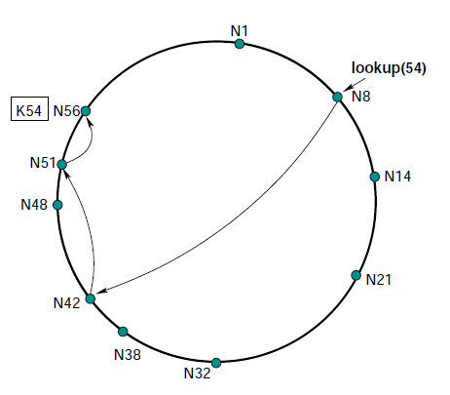
Dynamo in practice
Suppose key should map to N56
Dynamo replicates data
on neighboring nodes
(N1 here)
Will also save key,value
on subsequent nodes if
targets don’t respond
Data migrates to correct
location eventually
CS5412 Spring 2014 (Cloud Computing: Birman)

Slide 14
Dynamo in practice
When Amazon rolled Dynamo out, there was a huge need for scalable key-value storage, and Dynamo responded to this (e.g. shopping cart)
But in fact it wasn’t popular with people more familiar with database APIs
Eventually Amazon introduced Dynamo-DB which has a “NoSQL” API: SQL but with weak consistency. This has been far more successful for many uses.
CS5412 Spring 2014 (Cloud Computing: Birman)

Slide 15
Lessons learned?
Notice that we started with Chord: a DHT for big P2P uses. But nobody has big P2P systems!
Dynamo was initially just Chord adapted for use inside a data-center, as a service, adjusted to deal with the peculiar failure patterns seen at Amazon.
But ultimately, with Dynamo-DB, Amazon was forced to change the “model” to bridge to developers.
CS5412 Spring 2014 (Cloud Computing: Birman)

Slide 16
BigTable
Yet another key-value store!
Built by Google over their GFS file system and Chubby lock service
Idea is to create a flexible kind of table that can be expanded as needed dynamically
Like Dynamo-DB, starts with a DHT idea but then grew to become a specialized solution with many features
CS5412 Spring 2014 (Cloud Computing: Birman)

Slide 17
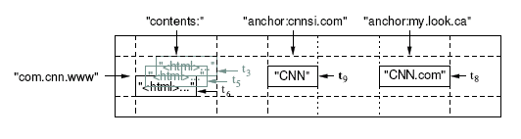
Data model: a big map
<Row, Column, Timestamp> triple for key Arbitrary “columns” on a row-by-row basis
  Column family:qualifier. Family is heavyweight, qualifier lightweight
  Column-oriented physical store- rows are sparse!
Does not support a relational model
  No table-wide integrity constraints
  No multirow transactions
CS5412 Spring 2014 (Cloud Computing: Birman)

Slide 18
API
Metadata operations
  Create/delete tables, column families, change metadata
Writes (atomic)
  Set(): write cells in a row
  DeleteCells(): delete cells in a row
  DeleteRow(): delete all cells in a row
Reads
  Scanner: read arbitrary cells in a bigtable
    Each row read is atomic
    Can restrict returned rows to a particular range
    Can ask for just data from 1 row, all rows, etc.
    Can ask for all columns, just certain column families, or specific columns
CS5412 Spring 2014 (Cloud Computing: Birman)

Slide 19
Versions
Data has associated version numbers
  To perform a transaction, create a set of pages all using some new version number
  Then can atomically install them
For reads can let BigTable select the version or can tell it which one to access
CS5412 Spring 2014 (Cloud Computing: Birman)

Slide 20
SSTable
Immutable, sorted file of key-value pairs
Chunks of data plus an index
  Index is of block ranges, not values
64K block
64K block
64K block
SSTable
Index
CS5412 Spring 2014 (Cloud Computing: Birman)

Slide 21
Tablet
Contains some range of rows of the table
Built out of multiple SSTables
Tablet
Start:aardvark
End:apple
64K block
64K block
64K block
SSTable
64K block
64K block
64K block
SSTable
Index
Index
CS5412 Spring 2014 (Cloud Computing: Birman)

Slide 22
Table
Multiple tablets make up the table
SSTables can be shared
Tablets do not overlap, SSTables can overlap
Tablet
Tablet
aardvark
apple
apple_two_E
boat
SSTable
SSTable
SSTable
SSTable
CS5412 Spring 2014 (Cloud Computing: Birman)

Slide 23
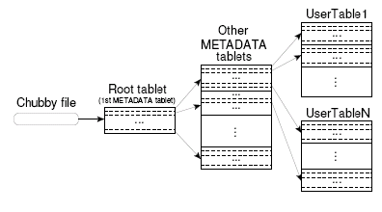
Finding a tablet
Stores: Key: table id + end row, Data: location
Cached at clients, which may detect data to be incorrect
  in which case, lookup on hierarchy performed
Also prefetched (for range queries)
CS5412 Spring 2014 (Cloud Computing: Birman)

Slide 24
Servers
Tablet servers manage tablets, multiple tablets per server. Each tablet is 100-200 MB
  Each tablet lives at only one server
  Tablet server splits tablets that get too big
Master responsible for load balancing and fault tolerance
CS5412 Spring 2014 (Cloud Computing: Birman)

Slide 25
Master’s Tasks
Use Chubby to monitor health of tablet servers, restart failed servers
  Tablet server registers itself by getting a lock in a specific directory chubby
    Chubby gives “lease” on lock, must be renewed periodically
    Server loses lock if it gets disconnected
  Master monitors this directory to find which servers exist/are alive
    If server not contactable/has lost lock, master grabs lock and reassigns tablets
    GFS replicates data. Prefer to start tablet server on same machine that the data is already at
CS5412 Spring 2014 (Cloud Computing: Birman)

Slide 26
Master’s Tasks (Cont)
When (new) master starts
  grabs master lock on chubby
    Ensures only one master at a time
  Finds live servers (scan chubby directory)
  Communicates with servers to find assigned tablets
  Scans metadata table to find all tablets
    Keeps track of unassigned tablets, assigns them
    Metadata root from chubby, other metadata tablets assigned before scanning.
CS5412 Spring 2014 (Cloud Computing: Birman)

Slide 27
Metadata Management
Master handles
  table creation, and merging of tablet
Tablet servers directly update metadata on tablet split, then notify master
  lost notification may be detected lazily by master
CS5412 Spring 2014 (Cloud Computing: Birman)

Slide 28
Editing a table
Mutations are logged, then applied to an in-memory memtable
  May contain “deletion” entries to handle updates
  Group commit on log: collect multiple updates before log flush
Tablet
Memtable
Insert
Insert
Memory
apple_two_E
boat
Delete
tablet log
Insert
Delete
SSTable
SSTable
GFS
Insert
CS5412 Spring 2014 (Cloud Computing: Birman)

Slide 29
Programming model
Application reads information
Uses it to create a group of updates
Then uses group commit to install them atomically
  Conflicts? One “wins” and the other “fails”, or perhaps both attempts fail
  But this ensures that data moves in a predictable manner version by version: a form of the ACID model!
Thus BigTable offers strong consistency
CS5412 Spring 2014 (Cloud Computing: Birman)

Slide 30
Compactions
Minor compaction – convert the memtable into an SSTable
  Reduce memory usage
  Reduce log traffic on restart
Merging compaction
  Reduce number of SSTables
  Good place to apply policy “keep only N versions”
Major compaction
  Merging compaction that results in only one SSTable
  No deletion records, only live data
CS5412 Spring 2014 (Cloud Computing: Birman)

Slide 31
Locality Groups
Group column families together into an SSTable
  Avoid mingling data, e.g. page contents and page metadata
  Can keep some groups all in memory
Can compress locality groups
Bloom Filters on SSTables in a locality group
  bitmap on keyvalue hash, used to overestimate which records exist
  avoid searching SSTable if bit not set
Tablet movement
  Major compaction (with concurrent updates)
  Minor compaction (to catch up with updates) without any concurrent updates
  Load on new server without requiring any recovery action
CS5412 Spring 2014 (Cloud Computing: Birman)

Slide 32
Log Handling
Commit log is per server, not per tablet (why?)
  complicates tablet movement
  when server fails, tablets divided among multiple servers
    can cause heavy scan load by each such server
    optimization to avoid multiple separate scans: sort log by (table, rowname, LSN), so logs for a tablet are clustered, then distribute
GFS delay spikes can mess up log write (time critical)
  solution: two separate logs, one active at a time
  can have duplicates between these two
CS5412 Spring 2014 (Cloud Computing: Birman)

Slide 33
Immutability
SSTables are immutable
  simplifies caching, sharing across GFS etc
  no need for concurrency control
  SSTables of a tablet recorded in METADATA table
  Garbage collection of SSTables done by master
  On tablet split, split tables can start off quickly on shared SSTables, splitting them lazily
Only memtable has reads and updates concurrent
  copy on write rows, allow concurrent read/write
CS5412 Spring 2014 (Cloud Computing: Birman)

Slide 34
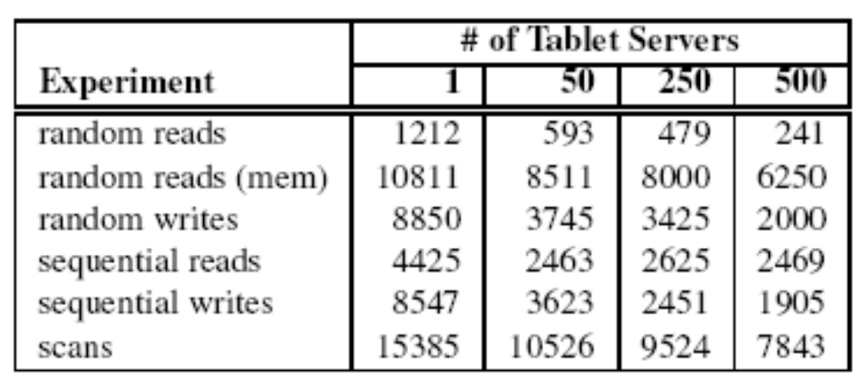
Microbenchmarks
CS5412 Spring 2014 (Cloud Computing: Birman)

Slide 35
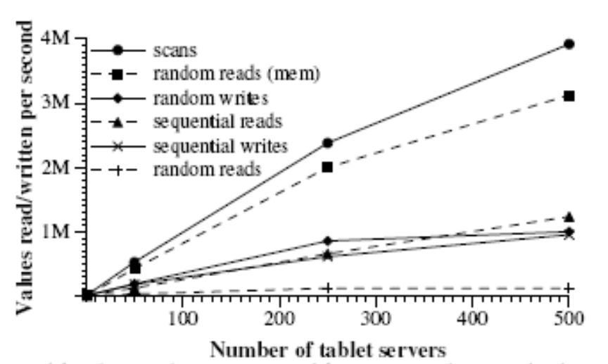
Performance
CS5412 Spring 2014 (Cloud Computing: Birman)

Slide 36
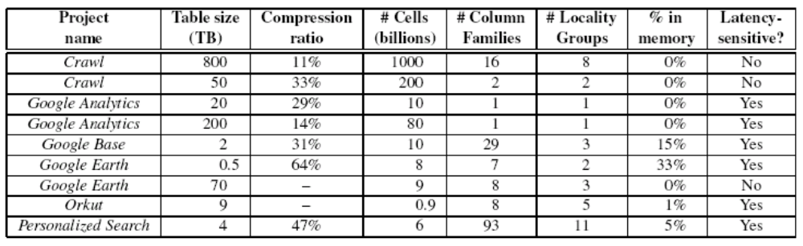
Application at Google
CS5412 Spring 2014 (Cloud Computing: Birman)

Slide 37
GFS and Chubby
GFS file system used under the surface for storage
  Has a master and a set of chunk servers
  To access a file, ask master… it directs you to some chunk server and provides a capability
  That server sends you the data
Chubby lock server
  Implements locks with varying levels of durability
  Implemented over Paxos, a protocol we’ll look at a few lectures from now
CS5412 Spring 2014 (Cloud Computing: Birman)

Slide 38
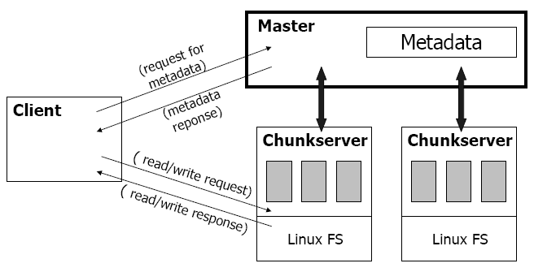
GFS Architecture
CS5412 Spring 2014 (Cloud Computing: Birman)

Slide 39
Write Algorithm is trickier
1. Application originates write request.
2. GFS client translates request from (filename, data) -> (filename, chunk index), and sends it to master.
3. Master responds with chunk handle and (primary + secondary) replica locations.
4. Client pushes write data to all locations. Data is stored in chunkservers’ internal buffers.
5. Client sends write command to primary.
CS5412 Spring 2014 (Cloud Computing: Birman)

Slide 40
Write Algorithm is trickier
6. Primary determines serial order for data instances stored in its buffer and writes the instances in that order to the chunk.
7. Primary sends serial order to the secondaries and tells them to perform the write.
8. Secondaries respond to the primary.
9. Primary responds back to client.
Note: If write fails at one of chunkservers, client is informed and retries the write.
CS5412 Spring 2014 (Cloud Computing: Birman)

Slide 41
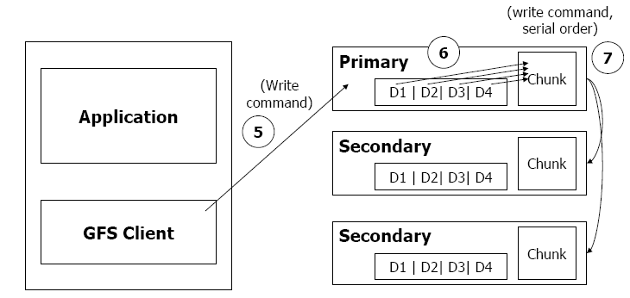
Write Algorithm is trickier
CS5412 Spring 2014 (Cloud Computing: Birman)

Slide 42
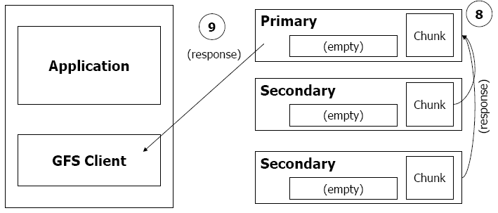
Write Algorithm is trickier
CS5412 Spring 2014 (Cloud Computing: Birman)

Slide 43
We’ve only scratched the surface
We’ve focused on scalable storage
But there are many other major, important services
What are some examples? We don’t have time for deep dives but can at least mention a few…
CS5412 Spring 2014 (Cloud Computing: Birman)

Slide 44
Zookeeper
Created at Yahoo!
Integrates locking and storage into a file system
  Files play the role of locks
  Also has a way to create unique version or sequence numbers
  But basic API is just like a Linux file system
Implemented using virtual synchrony protocols (we’ll study those too, when we talk about Paxos)
Extremely popular, widely used
CS5412 Spring 2014 (Cloud Computing: Birman)

Slide 45
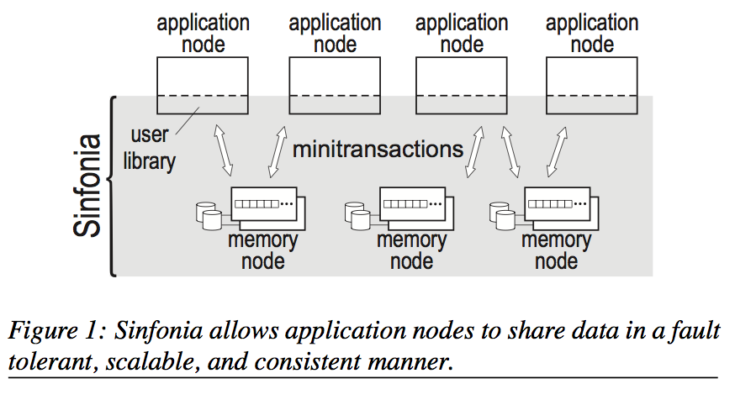
Sinfonia
Created at HP Labs
  Core construct: durable append-only log replicated for high availability and fast load-balanced reads
  Concept of a “mini-transaction” that appends to the state
  Then “specialized” by a series of plug-in modules
    Can support a file system
    Lock service
    Event notification service
    Message queuing system
    Database system…
Like Chubby, uses Paxos at the core
CS5412 Spring 2014 (Cloud Computing: Birman)

Slide 46
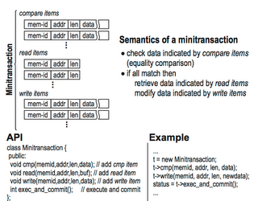
Sinfonia
To assist developer in
gaining more speed,
application can precompute
transaction using cached data
At transaction execution time
we check validity of the data
read during precomputation
Thus the transation can just
do a series of writes at high
speed, without delay to think
CS5412 Spring 2014 (Cloud Computing: Birman)

Slide 47
Key idea in Sinfonia
A persistent, append-oriented durable log offers
  Strong guarantees of consistency
  Very effective fault-tolerance, if implemented properly
  A kind of version-history model
We can generalize from this to implement all those other applications by using Sinfonia as a version store or a data history
  Seen this way, very much like the BigTable “story”!
CS5412 Spring 2014 (Cloud Computing: Birman)

Slide 48
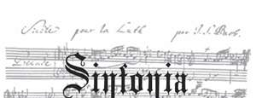
Second idea
Precomputation allows us to create lots of read-only data replicas that can be used for offline computation
  Sometimes it can be very slow to compute a database operation, like a big join
  So we do this “offline” permitting massive speedups
By validating that the data didn’t change we can then apply just the updates in a very fast transaction after we’ve figured out the answer
  Note that if we “re-ran” the whole computation we would get the same answers, since inputs are unchanged!
CS5412 Spring 2014 (Cloud Computing: Birman)

Slide 49
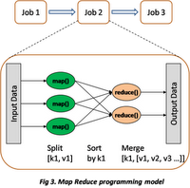
MapReduce
Used for functional style of computing with
massive numbers of machines and huge data sets
Works in a series of stages
  Map takes some operations and “maps” it on a set of servers so that each does some part
  The operations are functional: they don’t modify the data they read and can be reissued if needed
  Result: a large number of partial results, each from running the function on some part of the data
  Reduce combines these partial results to obtain a smaller set of result files (perhaps just one, perhaps a few)
Often iterates with further map/reduce stages
CS5412 Spring 2014 (Cloud Computing: Birman)

Slide 50
Hadoop
Open source MapReduce
  Has many refinements and improvements
  Widely popular and used even at Google!
Challenges
  Dealing with variable sets of worker nodes
  Computation is functional; hard to accommodate adaptive events such as changing parameter values based on rate of convergence of a computation
CS5412 Spring 2014 (Cloud Computing: Birman)

Slide 51
Classic MapReduce examples
Make a list of terms appearing in some set of web pages, counting the frequency
Find common misspellings for a word
Sort a very large data set via a partitioning merge sort
Nice features:
  Relatively easy to program
  Automates parallelism, failure handling, data management tasks
CS5412 Spring 2014 (Cloud Computing: Birman)

Slide 52
MapReduce debate
The database community dislikes MapReduce
  Databases can do the same things
  In fact can do far more things
  And database queries can be compiled automatically into MapReduce patterns; this is done in big parallel database products all the time!
Counter-argument:
  Easy to customize MapReduce for a new application
  Hadoop is free, parallel databases not so much…
CS5412 Spring 2014 (Cloud Computing: Birman)

Slide 53
Summary
We’ve touched upon a series of examples of cloud computing infrastructure components
  Each really could have had a whole lecture
They aren’t simple systems and many were very hard to implement!
  Hard to design… hard to build… hard to optimize for stable and high quality operation at scale
  Major teams and huge resource investments
  Design decisions that may sound simple often required very careful thought and much debate and experimentation!
CS5412 Spring 2014 (Cloud Computing: Birman)

Slide 54
Summary
Some recurring themes
  Data replication using (key,value) tuples
  Anticipated update rates, sizes, scalability drive design
  Use of multicast mechanisms: Paxos, virtual synchrony
  Need to plan adaptive behaviors if nodes come and go, or crash, while system is running
  High value for “latency tolerant” solutions
    Extremely asynchronous structures
    Parallel: work gets done “out there”
Many offer strong consistency guarantees, but not necessarily for every aspect. “Selective” guarantees.
CS5412 Spring 2014 (Cloud Computing: Birman)

